Slide 1
Software Design Patterns

Slide 2
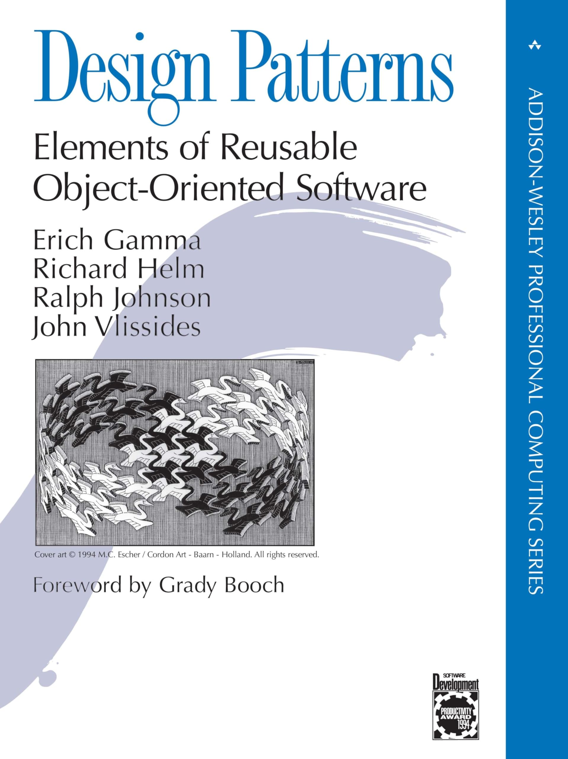
What are design patterns anyway?
1994
“Design patterns are proven, reusable solutions to common problems in software design. They help create flexible, maintainable, and scalable code by offering best practices for structuring and organizing software.”
While historically common in OOP, the concept of “coding pattern” has been expanded to other programming fields

Slide 3

I don’t need patterns, I have Cursor!
Notes:
Even though AI-assisted coding is very strong, programming is not only writing code, it still has a big human factor and also, current LLMs, while they know software patterns better than anyone, they don’t know the full picture of your product, so a good architecture and good coding practices are more important than ever, to properly guide these models

Slide 4
What does a pattern consist of?
Most patterns are described very formally so people can reproduce them in many contexts
A pattern consists of:
Intent, describing both the problem and the solution
Diagram (e.g., UML), showing how each part of the pattern are related
Code example, making it easier to understand

Slide 5
Classification of patterns
Traditional design patterns are usually categorized in three main groups:
Creational patterns
Structural patterns
Behavioral patterns

Slide 6
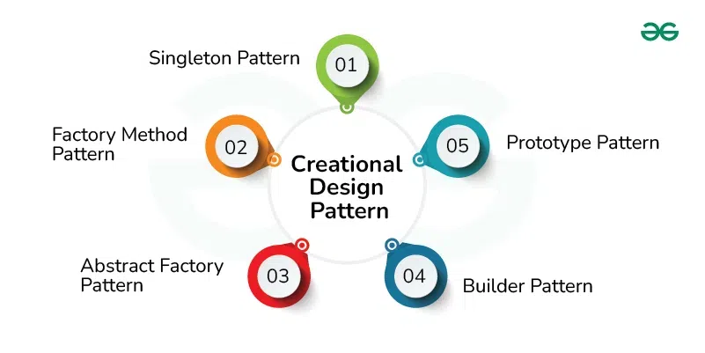
Creational Design Patterns
How to create objects in a flexible and reusable way

Slide 7
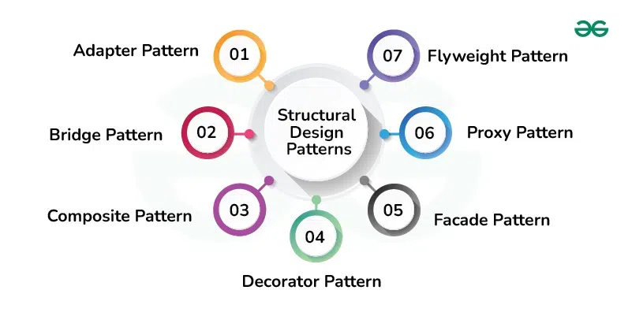
Structural Design Patterns
How to assemble objects and classes into larger structures

Slide 8
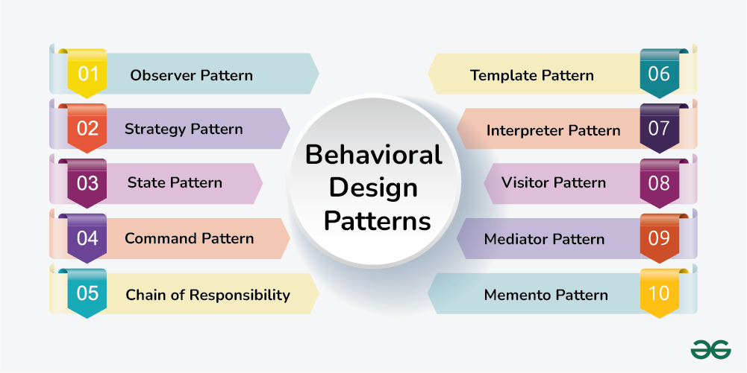
Behavioral Design Patterns
How to distribute responsibility among objects

Slide 9
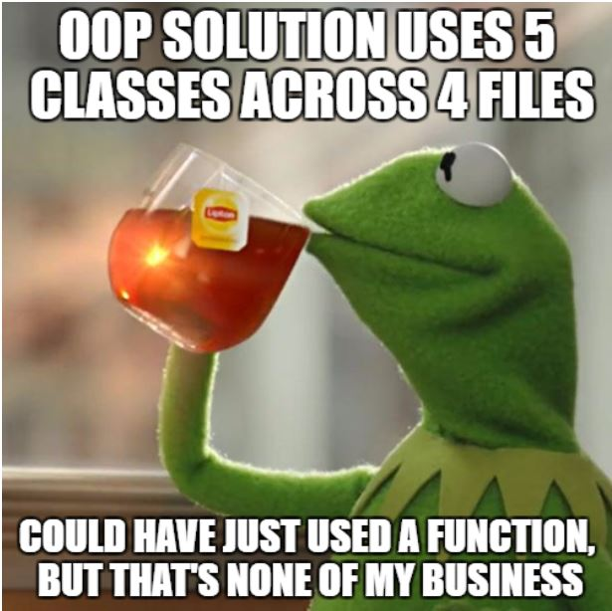
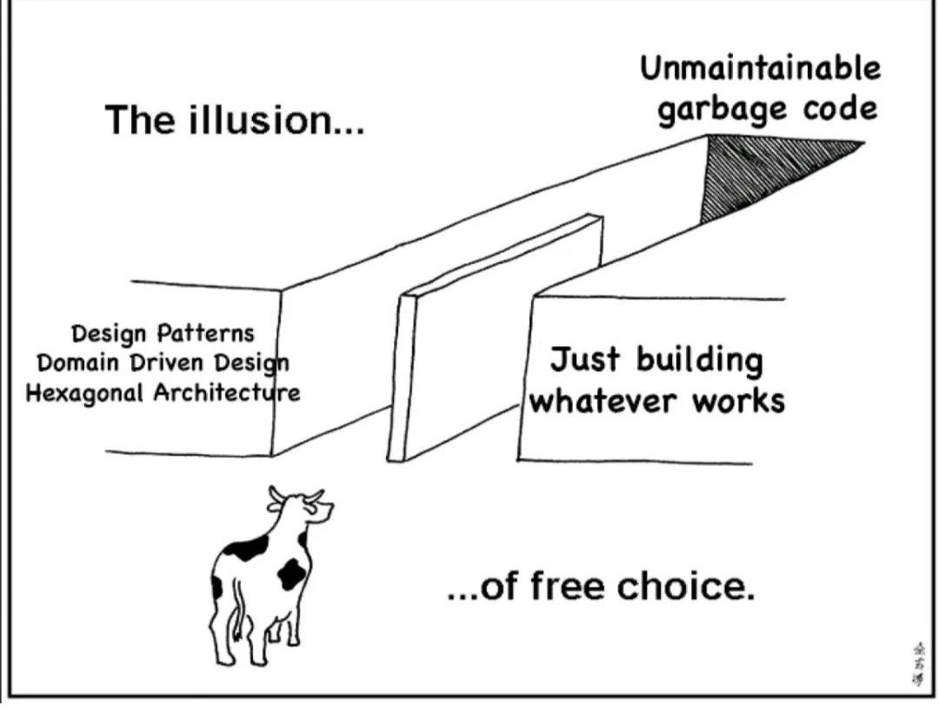
A Word of Caution
Patterns are not the Panacea
Patterns + Common Sense + Proper Documentation = Dream Solution?
Notes:
Design patterns can lead to unnecessary complexity (especially in small projects)
Sometimes developers follow design patterns religiously without understanding the real problem or alternative solutions.
This leads to boilerplate-heavy, inflexible code.
The intention of the pattern gets lost.
Some argue that design patterns exist mainly to patch the limitations of older programming languages. There is some truth there, some of these ideas have been integrated in languages, like the Strategy pattern, which can sometimes be replaced by higher-order functions in functional languages.

Slide 10



Where can I learn more?
https://refactoring.guru/design-patterns
https://www.geeksforgeeks.org/software-design-patterns/

Slide 11
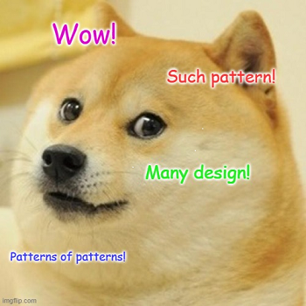
Thank you

